Slide 1


Preparation for CLiP
Enhancing Learning though Coaching Skills
Notes:
Tip: You will probably find it easiest to print these slides out as Notes Pages in the print options for your own reference during the training, as the notes section does not show up on Trust computers when you are showing the slide show.
The timing is likely to be fairly tight so do your best to stick to the timetable and if you have to shorten any sections. The course has been designed to allow the attendees to discover what coaching is (and how it differs from mentoring, not about providing advice, etc.) and learn the key skills/concepts through the design of the slides and practical sections, so you do not need to cover all of this at the beginning – just focus on what is on each slide and let the learning with unfold though self-discovery and experience.
Attendees will get the most out of the practical sections which should then be finished off with a discussion (prompted in the notes). It will be these discussions that could be susceptible to being drawn out and eat into time, so your challenge will be to keep the discussions fairly succinct and focused on the skills rather than getting into too much detail around case studies etc. Of course this is all about balance as discussing the case studies is necessary to some extent.

Slide 2

Notes:
Amsterdam to enable the increased nursing student capacity following a recruitment drive
UEA undertaken the pilot and has been running now for 3 years

Slide 3

Notes:
VUmc Amsterdam identified two key differences between what was being delivered in Amsterdam and what we are delivering in the UK. The model is distinct from the traditional mentorship model (Fig.1) in both the way practice learning is organised and in the philosophy that underpins how students learn in practice. Organizationally, under the new CLiP model (Fig.2), rather than working individually with a mentor, students work collaboratively alongside other students under the guidance of a day coach. Typically, on any particular shift, one day coach will be responsible for a group of patients, the care of whom is primarily delivered by students. Coaching underpins the philosophy of learning so that students are supported to take on greater responsibility for their learning and the learning environment embraces a culture of valuing student-focused solutions to care.

Slide 4
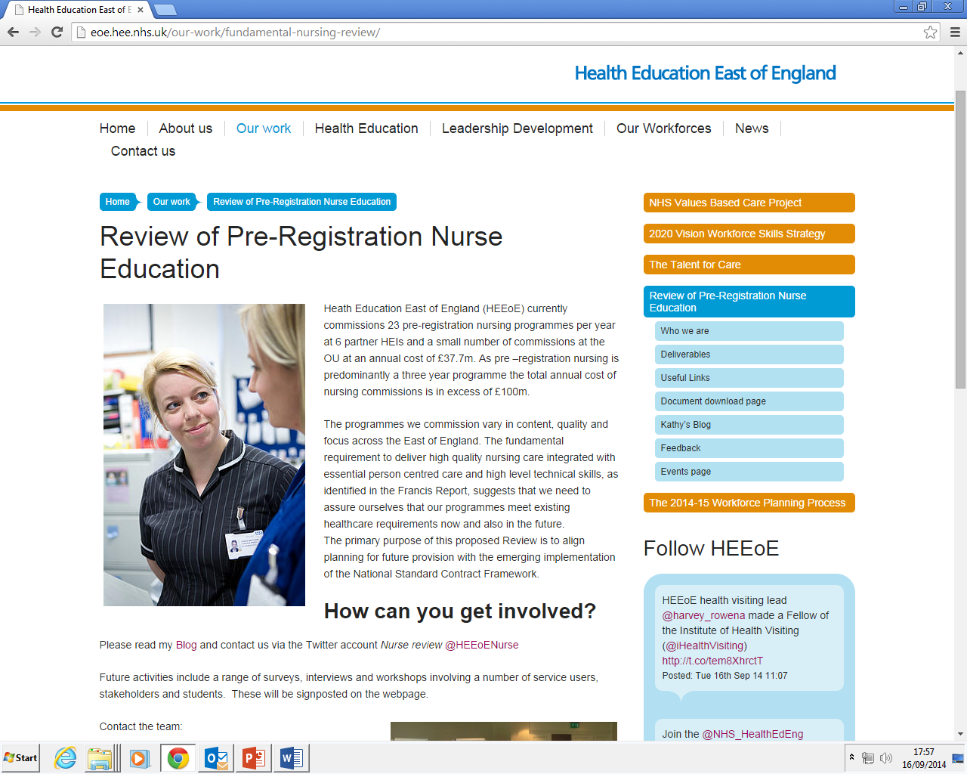
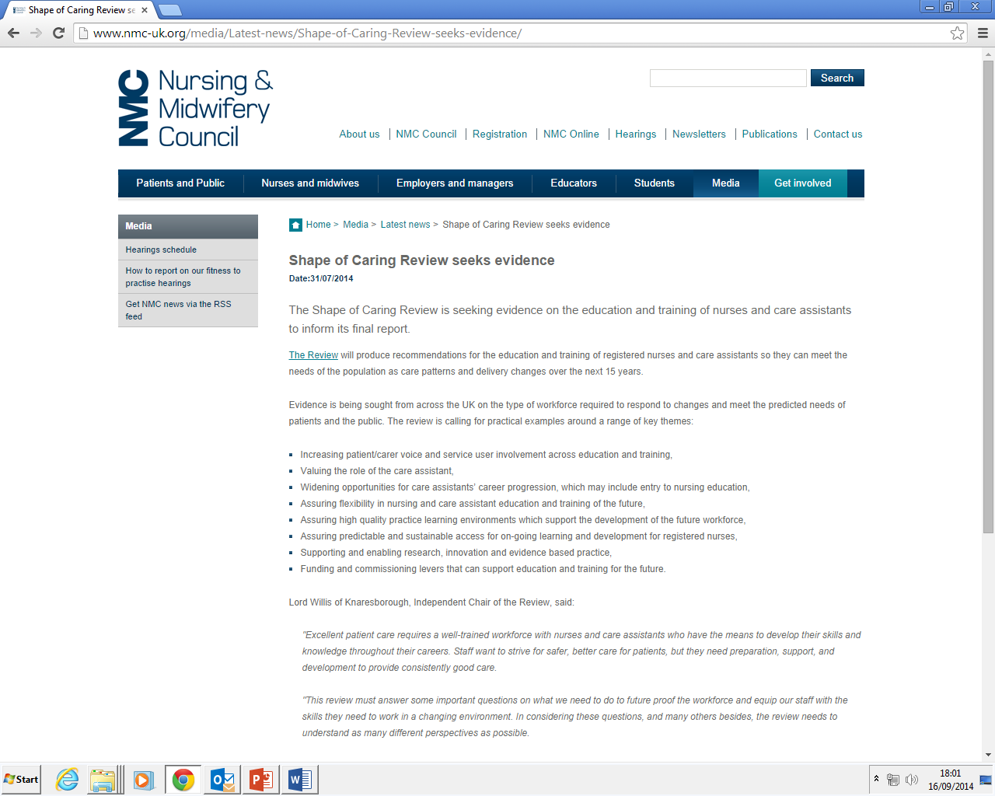
Drivers
Notes:
It is important to be aware of the other drivers that have made and are making a significant impact on the need to change the current model of practice learning.
The first Mid staffs inquiry was key in focussing our energies into developing a robust and systematic process that collated, reviewed and actioned practice evaluations. It also put nursing and nurse education in the spotlight
The subsequent Willis commission highlighted the need for better theory practice integration at organisational and structural levels
Of course the more recent Francis report has significantly placed at centre stage the quality of care and the quality of the learning environment

Slide 5
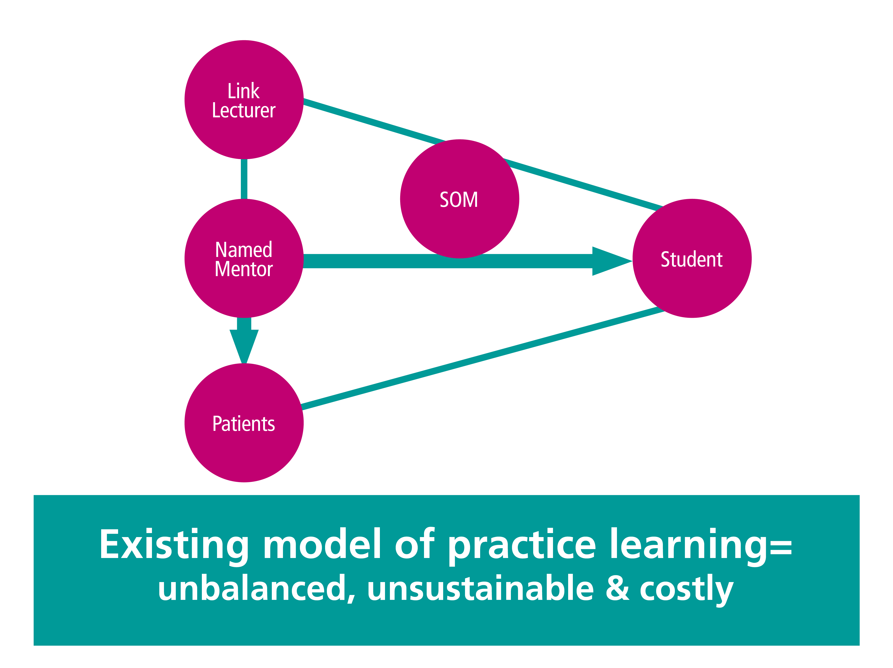
Traditional model of mentorship
Notes:
For those of you who might not be familiar with mentorship in nursing and midwifery, Our regulatory body, the nursing and midwifery council has set standards for the learning and assessment in practice for students and there is a requirement within these standards that all students are allocated a named mentor in practice who have undertake specific training and there is a requirement that students are able to access a mentor 40% of the time in practice.
Generally and locally this has evolved into a model of one mentor working with one student working at lease 40% of the time, sometimes supported by a link lecturer and a sign-0ff mentor in the final placement.

Slide 6
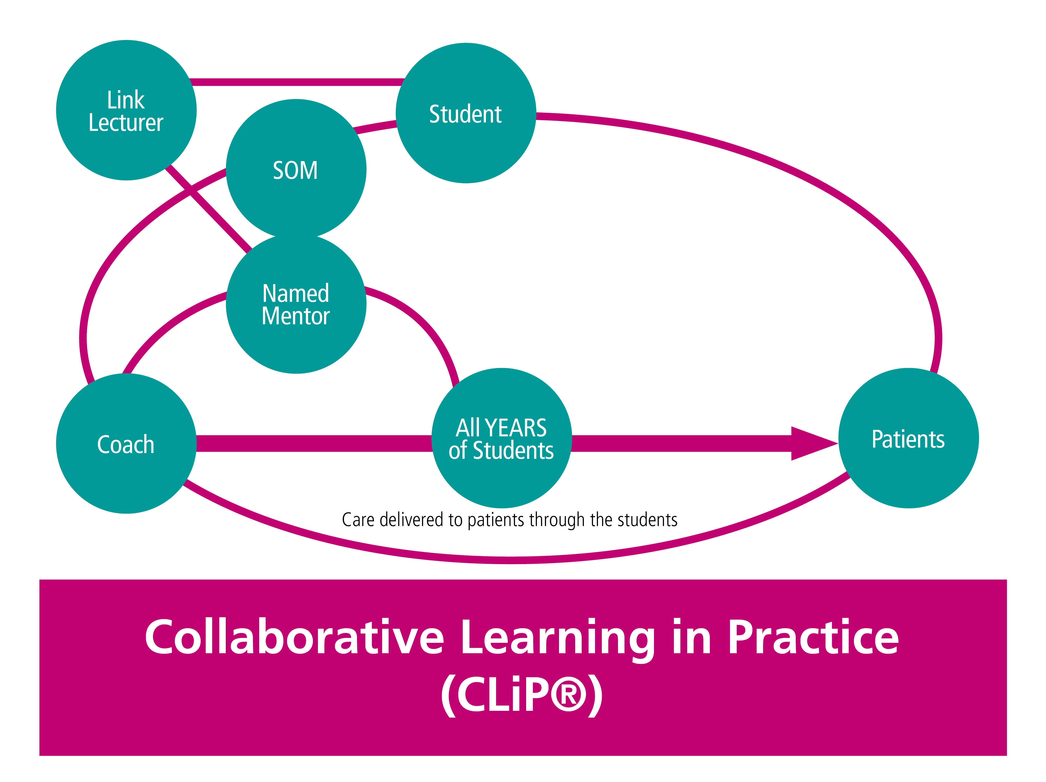
CLiP Model of Mentorship
Link Lecturer
Clinical Educator
SOM
Named Mentor
Students: Years 1-3
Coach
Patients
Care Delivered to Patients through students

Slide 7
Structure
One coach: 3 students
Coach has patient allocation and then this is shared between students
Mixture of students
Structured day
Student takes responsibility of learning
Better to have shifts with no students than 1 or 2 students per shift
Named mentor retains overall responsibility
What this means…
Coaches will step back
Questions more than answers
Students take responsibility for all the care of their patient
Assessment of competency
Students will access spokes in relation to their patient journey
The coach facilitates learning rather than simply provides the answers
More meaningful learning
Notes:
What coaching is will be expanded upon and developed over the rest of the session.
You chose what you want to work on: this leads meaningful learning tasks give students a clear sense of progress leading to mastery

Slide 8

The challenge for students is how they think about their experiences….

Slide 9






Students with a Growth Mindset
VS
Students with a Fixed Mindset
‘I will develop though my effort’
‘I am clever and always do well’
‘I’ll have a go and if it doesn’t work, I’ll improve’
‘I’d rather avoid challenge to save looking stupid’
‘I know if I try harder that I can do it’
‘I don’t think I’ll carry on, I’m not good enough’
‘If I get some feedback then I can do better’
‘I don’t really want feedback as I’m sure that was ok’
Notes:
Firstly ask the students to read the 2 different columns and ask which thoughts they identify with and which related to the last exercise - emphasise that they will not be judged!
Research shows that people often have 2 different mindsets: Those with a Growth mindset believe their abilities are fixed, they less likely to want to have a go at tasks where they may fail for fear of been seen as bad (not least by them selves).. Those with a Growth mindset see abilities and skills as things that develop through effort.
Research shows that the greatest learning takes place when we get things wrong – not when we get things right!
Within the CLiP project the coach will ask questions that you/students are not sure of. The natural thing will be to want to be told the answer however this won’t help as much trying to figure it out which will involve getting the answer wrong. Its about progression and developing through being challenged, not how smart you are or testing what you have learned

Slide 10

Notes:
This quote demonstrated a growth mindset perfectly
Studies have also shown that it is practice combined with feedback and focused development that makes all the difference whether people succeed at things or not – it is not about innate ability or being clever!

Slide 11
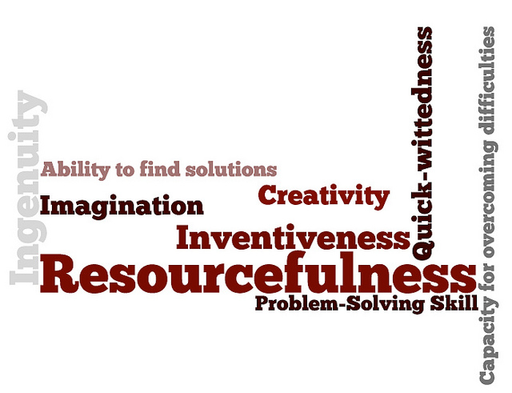
Benefits of CLiP
Notes:
You chose what you want to work on: meaningful learning tasks give students a clear sense of progress leading to mastery
Its about progression and developing through being challenged, not how smart you are or testing what you have learned
Students learn though being challenged to think for themselves
This increases resourcefulness, independence and will create more able nurses!

Slide 12
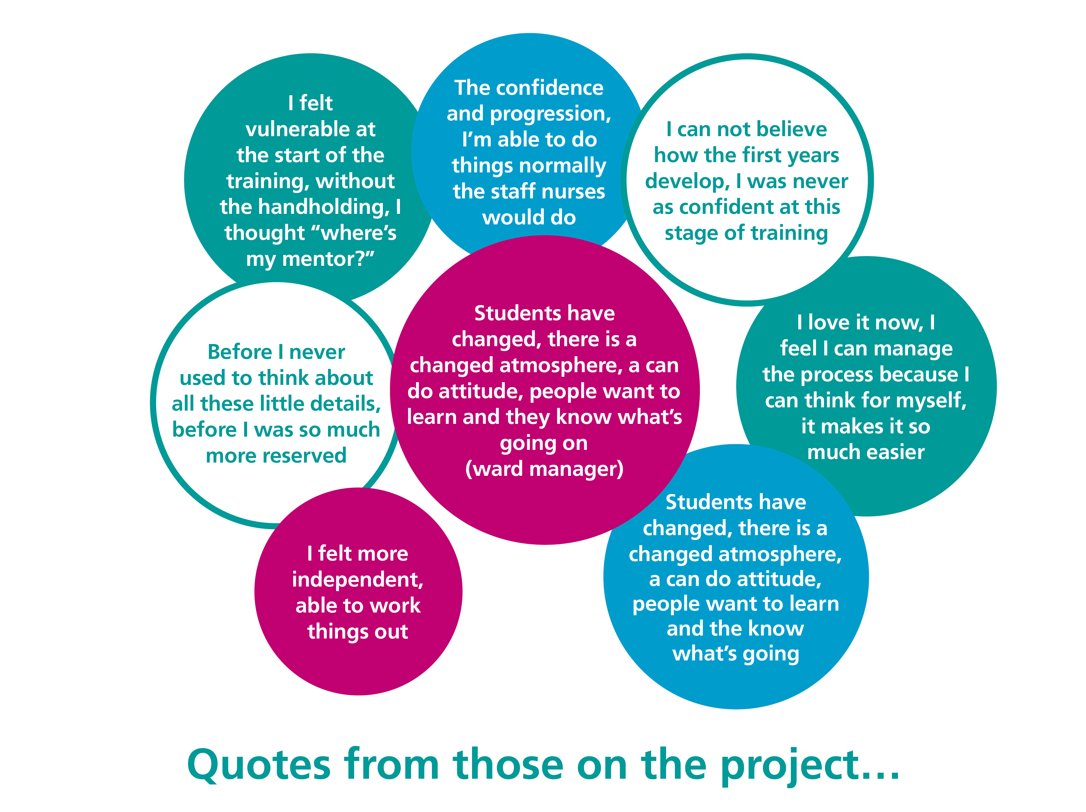
Quotes from those on the project…
“I felt vulnerable at the start of the training, without the handholding, I thought ‘where’s my mentor’”
I can not believe how the first years develop, I was never as confident at this stage of training
“The confidence and progression, I’m able to do things normally the staff nurses would do”
“Before I never used to think about all these little details, before I was so much more reserved”
“Students have changed, there is a changed atmosphere, a can do attitude, people want to learn and they know what’s going on”
(ward manager)
“I felt more independent, able to work things out”
“I love it now, I feel I can manage the process because I can think for myself, it makes it so much easier”

Slide 13

Name of Student: Date:
Name of Coach:
Overview of Learning Outcomes:
Goals for the day: What will be achieved? What will be the specific outcomes? | Current level of knowledge/ ability: Beginner- no previous experience with skill/no knowledge Intermediate- some previous experience/some knowledge Advanced- able to perform skill competently under supervision/ able to provide rationale | Plan: What will be done? How will the goal be achieved?
 | Please elaborate level of skill (reasons why)
Notes:
Talk through how, when and by whom the learner log is completed
To be completed daily by individual student
Directs own learning needs
Their own goal specific to them
Kept on ward for mentor and other coaches to access to aid assessment.
Kept at end of placement by student for their portfolio

Slide 14
Coach’s assessment/ feedback | Student self-reflection
Feedback on professional behaviour and performance, reassess competency in relation to days agreed L/O discuss unexpected achievements. Action plan to further develop skills | What has been learnt? What do you need to do more of or start doing? Is there anything you should do less or stop doing?
Coach signature: | Student signature:

Slide 15




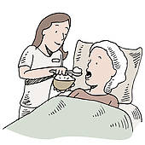




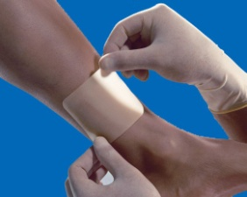





Any Questions?

Slide 16
For more information about CLiP
Please contact
Jonty Kenward (Collaborative Learning Manager) on EXT: 8111 or email jonty.kenward@lthtr.nhs.uk

